Slide 1

masters of data
ETL Project
Andrew Baker
Mays Mansoor
Romi Sinnigen
Fernando Flores

Slide 2
Introduction
Our website was mastersofdatascience.org. This website includes information about data science programs from across the nation as well as career advice for many data-related fields. Our focus was on breaking down the state data (i.e. the amount of different programs in each state). We will explain our ETL process/methods and the possible uses of the stored data.

Slide 3
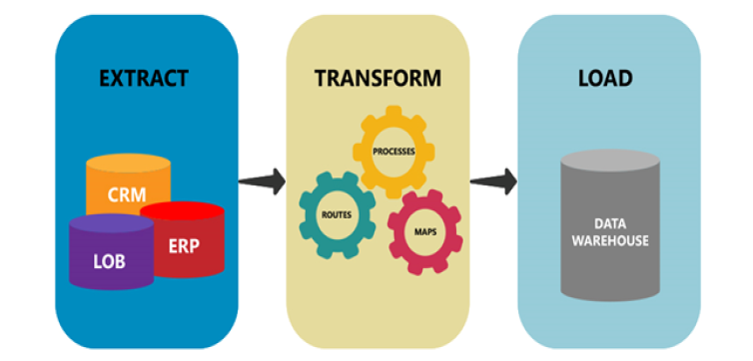
What To Cover Today

Slide 4
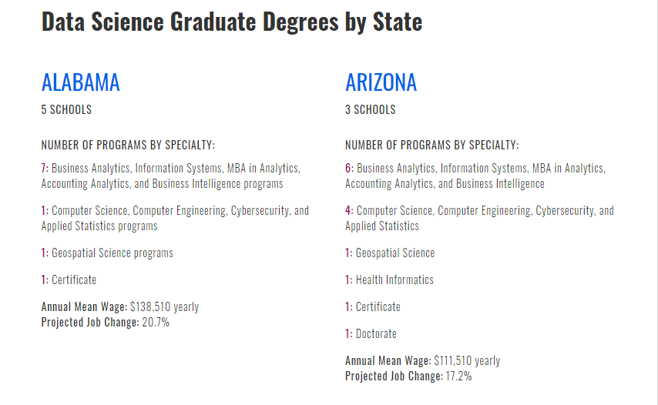
Data Extract

Slide 5
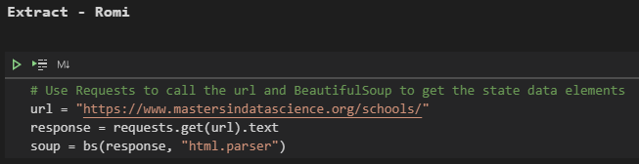
Extract 1:
Using the requests module, we can call the page URL and store the HTML. Once we have the HTML, we can parse it to create a BeautifulSoup object.

Slide 6
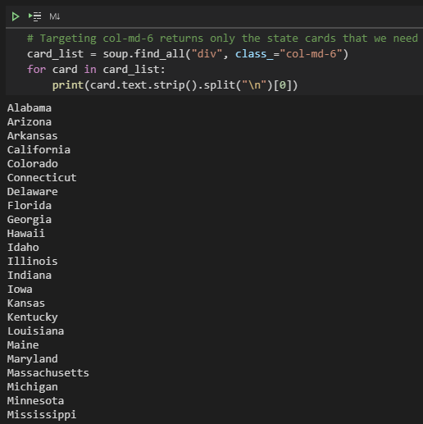
Extract 2:
After inspecting the site, we found that all of the states' "cards" were individual divs with the class of col-md-6. This Bootstrap class can be fairly common so to ensure that we captured only the states, we iterated through the list only printing the first line of text. If there were any entries that were not a state, then we would have needed to refine the code. Thankfully, we only captured state data.

Slide 7
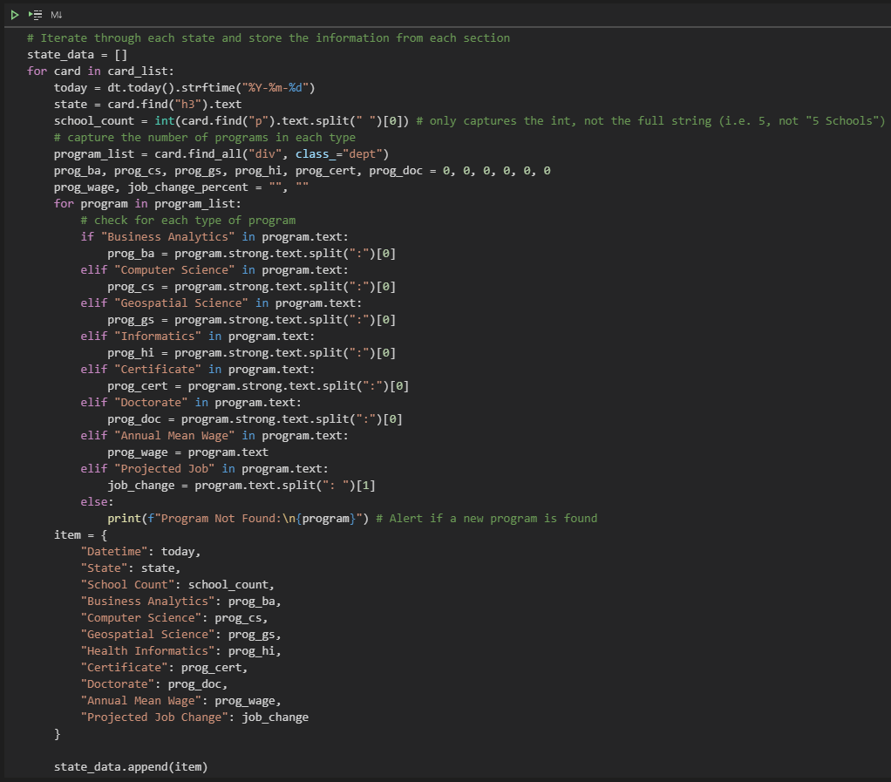
Extract 3:
With each state card saved in a list, we iterated through and parsed out each data field we wanted to collect:
of Schools
of Programs in Business Analytics
of Programs in Computer Science
of Programs in Geospatial Science
of Programs in Health Informatics
of Certificates
of Doctorates
*Annual Mean Wage
Each of these values were then saved to a dictionary and appended to a list for ease of converting to a Pandas Dataframe.

Slide 8
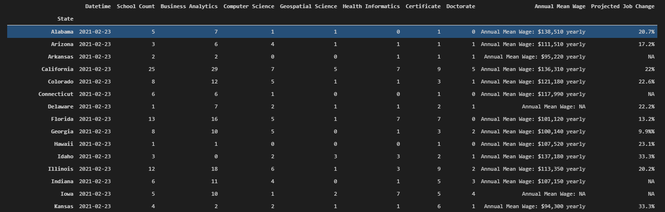
Data Transform

Slide 9
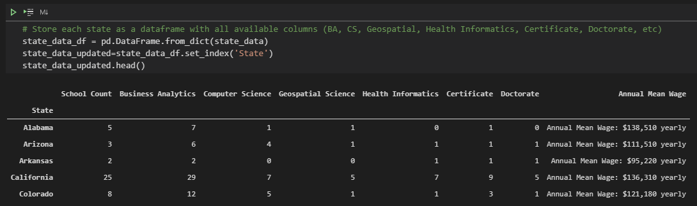
Transform 1:
The initial transform is converting the entire dictionary created in the extract portion, into a pandas Dataframe. This was done by using a .from_dict function and identifying the dictionary to pull from. Then setting the index to the "State" column

Slide 10
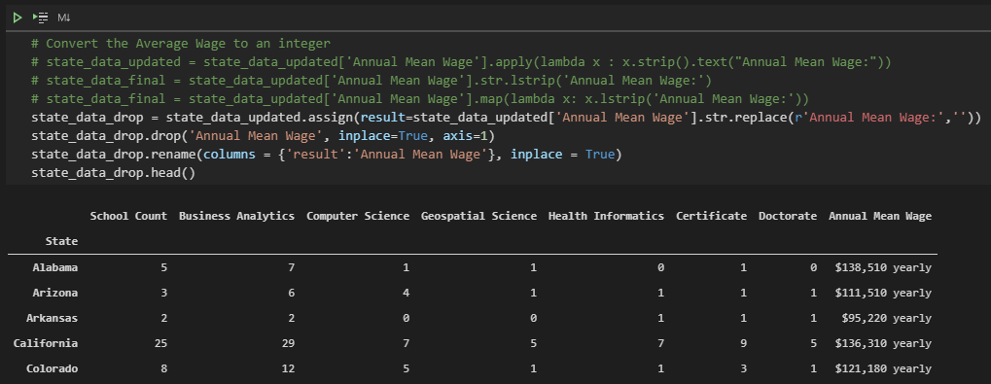
Transform 2:
The next part of transforming the data is adjusting the "Annual Mean Wage" column to reflect only integers. The first step was removing the text in front of the integer by using .str.replace. This action creates a new column with the removed information so the next step was the remove the original column and change the name of the new column.

Slide 11
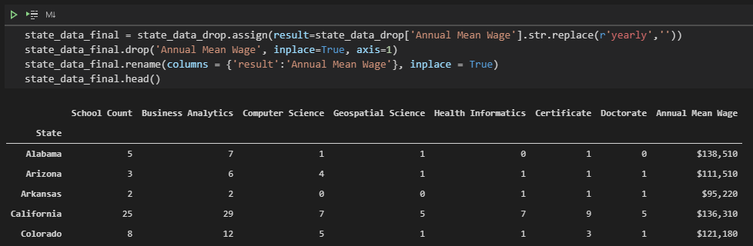
Transform 3:
This was similar to the process above but needing to remove the text behind the integer. The same function was used, .str.replace., and then again a new column was created and the old had to be removed.

Slide 12
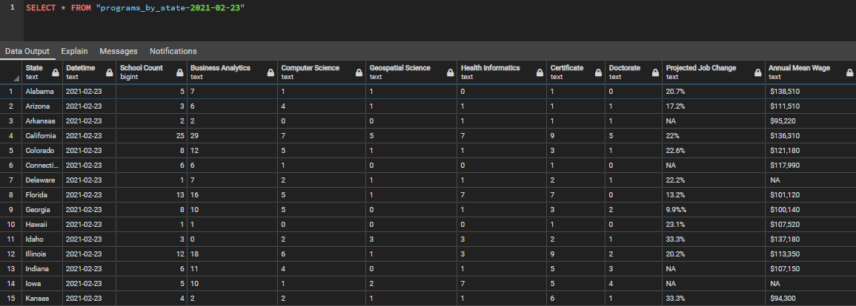
Data Load

Slide 13
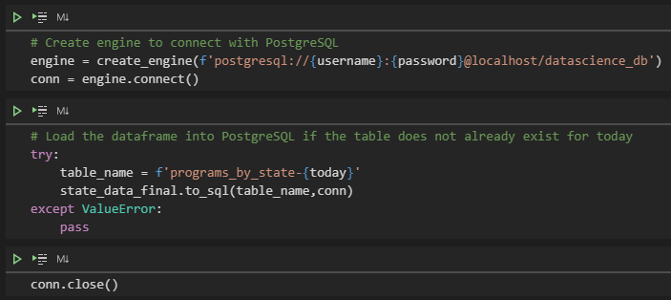
Load 1:
Using sqlalchemy we created an engine and connection to postgres in order to have it connect properly a database needs to be created in our local postgres named “Datascience_db" by running our code.

Slide 14
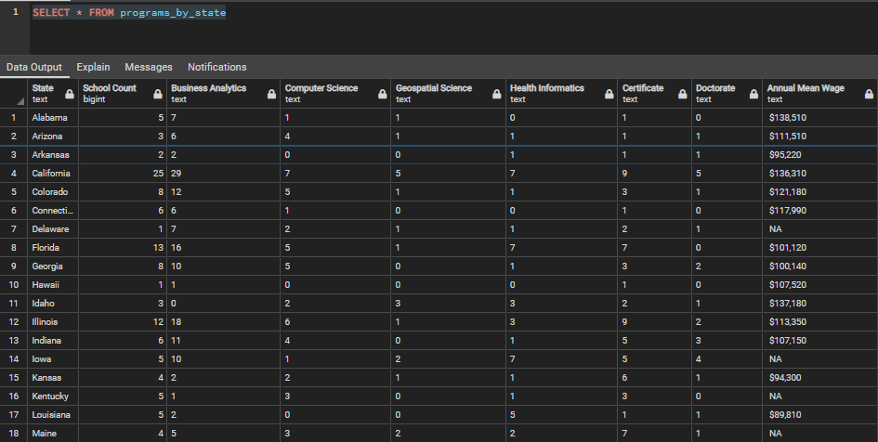
Load 2:
Table "programs_by_state" will be created in postgres datascience_db that includes the data stored in our Data frame.

Slide 15
Key Takeaways
What could this data be used for in the future?: Seeing what programs are available at a glance and what schools have what types of programs.
How often should we pull the data?: Because this is data that most likely wouldn’t change often, we could have it pulled every 3 months to see if classes have changed or if new classes have been added.
What can be examined of the data over time?: Over time we can see if the average wage has changed for the different masters programs based on location. We can also determine if projected job change will increase or decrease for each program over time.
Who would benefit from seeing a breakdown of the data?: This could be a great breakdown for students looking to decide what masters programs to get in to. This could also benefit anyone in the academic field to see if what they are teaching has real life applications.

Slide 16


